Slide 1
Methods of organic synthesis
Dr. A. S. Stella Shalini

Slide 2


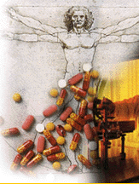
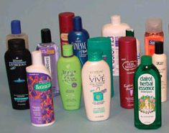
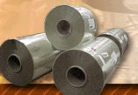
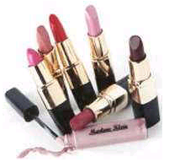
Many of the materials we use today are made by chemical synthesis. Most of the new compounds made today are organic.

Slide 3
Most of the new compounds made today are organic, that is, they are composed largely of carbon.
stable and versatile
unstable

Slide 4
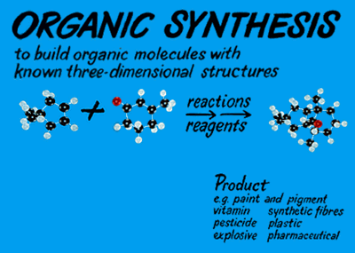
Product
e.g. paint and pigment vitamin synthetic fiber pesticide plastic explosive pharmaceutical

Slide 5
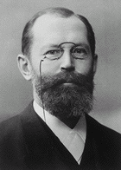
MAKING COMPLEX MOLECULES
Fischer achieved the first synthesis of the first truly complicated organic molecules, the sugar molecule D-glucose in 1890.
Hermann Emil Fischer
Germany
(1852-1919)
D-Glucsoe
The Nobel Prize
in Chemistry 1902
Fischer’s work on the total synthesis of D-glucose is regarded as the catalyst for the development of synthetic organic chemistry in the 20th century.

Slide 6
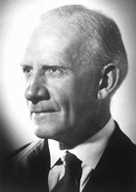
Sir Robert Robinson
United Kingdom
(1886-1975)
Willstatter’s synthesis of tropine
The Nobel Prize
in Chemistry 1947
Robinson’s synthesis of tropinone in 1917
The Robinson’s synthesis of tropinone was hailed as revolutionary. This was to look at the target molecule and try to imagine how the molecule could be constructed from simpler chemical units.

Slide 7
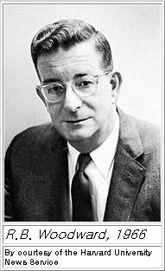
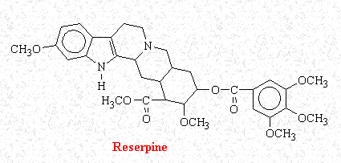
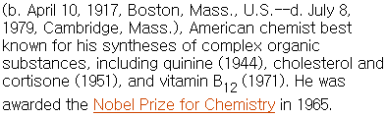
Robert Burns Woodward

Slide 8
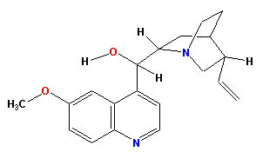
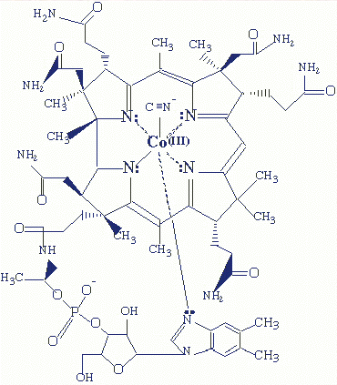
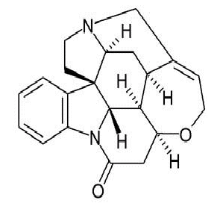
Some of the Complex Molecules Made by Woodward
“There is excitement, adventure, and challenge, and there can be great art in organic synthesis.”
- Woodward
Quinine (1944)
anti-malarial drug
Vitamin B12 (1973)
Strychnine (1954)
pesticide

Slide 9
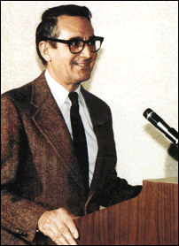
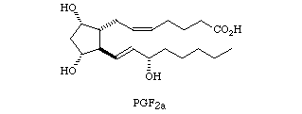
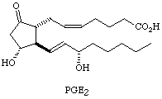
Prostaglandins
Corey, Elias James
1928–, American organic chemist and educator, b. Methuen, Mass., grad. Massachusetts Institute of Technology (B.S. 1948, Ph.D. 1951). In 1990, he was awarded the Nobel Prize in Chemistry.
Some prostaglandins affect human blood pressure at concentrations as low as 0.1 microgram per kilogram of body weight.
Substances that inhibit prostaglandin synthesis may be useful in controlling pain, asthma attacks, and anaphylactic shock and in reducing the clotting ability of blood.

Slide 10
Organic Synthesis:
Intentional construction of molecules by means of chemical reactions.
Carbon-Carbon Bond Formation
Functional Group Interconversion
Efficiency and selectivity are important characteristics that have to be taken into account.
[Efficiency: yields, number of steps]
[Selectivity: chemoselectivity, regioselectivity, stereoselectivity]

Slide 11
The importance of synthesis
Prove structure of synthesized product
Gain insights to reactivity based on structure
Test synthetic methodology
development of new synthetic methodology
Apply or test a biological utility or theory
Gain knowledge of the molecular architecture of product for drug testing

Slide 12
Functional Groups
  A functional group is an atom or a group of atoms with characteristic chemical and physical properties.
  An atom or group of atoms that influences the way the molecule functions, reacts or behaves.
It is the reactive part of the molecule.
Most organic compounds have C—C and C—H bonds. However, many organic molecules possess other structural features:
  Heteroatoms—atoms other than carbon or hydrogen.
  π Bonds—the most common π bonds occur in C—C and C—O double bonds.
  These structural features distinguish one organic molecule from another. They determine a molecule’s geometry, physical properties, and reactivity, and comprise what is called a functional group.

Slide 13
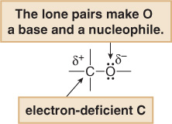
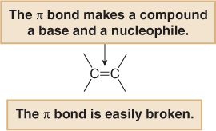
Heteroatoms and π bonds confer reactivity on a particular molecule.
  Heteroatoms have lone pairs and create electron-deficient sites on carbon.
  π Bonds are easily broken in chemical reactions. A π bond makes a molecule a base and a nucleophile.

Slide 14
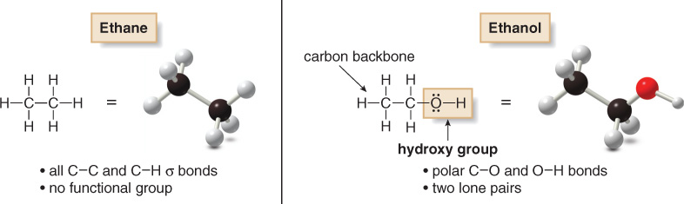

Slide 15
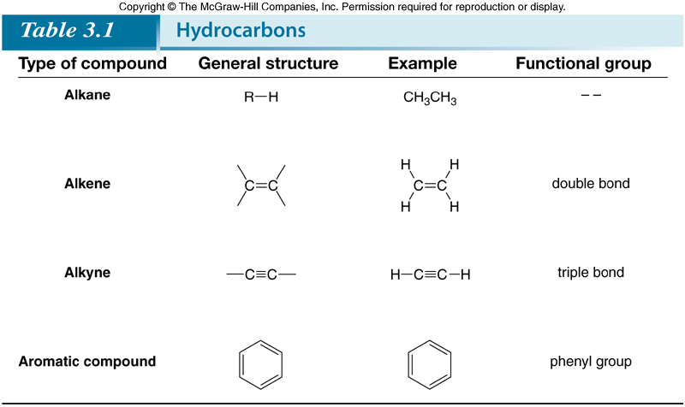
Hydrocarbons are compounds made up of only the elements carbon and hydrogen. They may be aliphatic or aromatic.

Slide 16
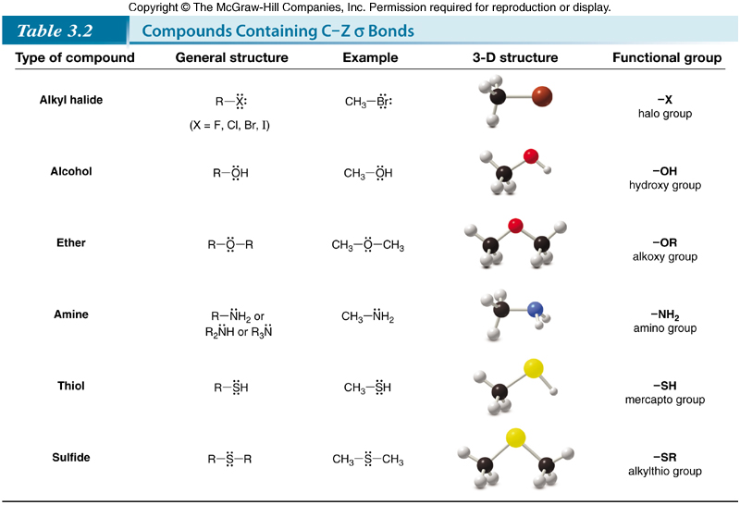

Slide 17
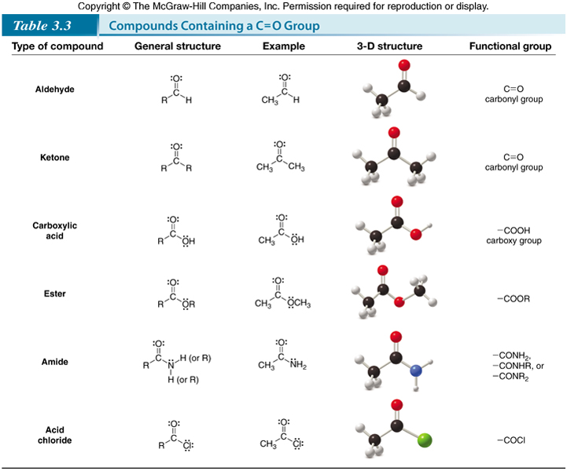

Slide 18
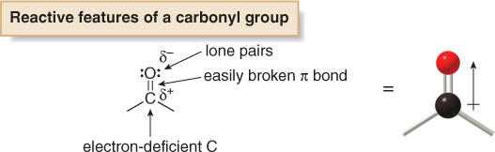
Compounds Containing the C=O Group:
This group is called a “carbonyl group”.
The polar C—O bond makes the carbonyl carbon an electrophile, while the lone pairs on O allow it to react as a nucleophile and base.
The carbonyl group also contains a π bond that is more easily broken than a C—O σ bond.

